Slide 1
Normalization
By Hargobind Singh

Slide 2
What Is Normalization
It is a technique to remove or reduce Redundancy From Table.
There are basically two type of redundancy in the database.
Row Level
Column Level

Slide 3
Problems due to Column Level Redundancy
Insertion Anomaly
Deletion Anomaly
Updation Anomaly

Slide 4
1 NF
Condition-
Table Should not contain any multivalued attribute.
Eg.
Reg_no | Name | Subjects
101 | Hargobind | DBMS,Big Data
102 | Virat | C,DBMS

Slide 5
Solutions If Table is not in 1NF
1. Split into multiple rows/records/tupples. (Think about PK)
Primary Key= Reg_no + Subjects (Known as Composite Primary Key)
Reg_no | Name | Subjects
101 | Hargobind | DBMS
101 | Hargobind | Big Data
102 | Virat | C
102 | Virat | DBMS

Slide 6
Solutions If Table is not in 1NF
2. Split into Multiple columns (Problem with Null Values)
Condition only 3 subjects are there…
3. Split into two Different Tables and use the concept of foreign Key.
Reg_no | Name | C | Big Data | DBMS
101 | Hargobind | - | 1 | 1
102 | Virat | 1 | - | 1

Slide 7
Solutions If Table is not in 1NF
3. . Split into two Different Tables and use the concept of foreign Key.
Reg_no (FK) | Subjects
101 | DBMS
101 | Big Data
102 | C
102 | DBMS
Reg_no(PK) | Name
101 | Hargobind
102 | Virat

Slide 8
Closure Method
Helps to find all the candidate keys in a table.
Table/Relation General Representation
R(A,B,C,D)
FD{A->B, B->C,C->D} CK={A}
A+->BCDA PRIME ATTRIBUTE->{A}
B+ ->CDB NON-PRIME ATTRIBUTE-> {BCD}
C+ -> DC
D+ -> D
Similarly Find Closure of B,C,D

Slide 9
Closure Method
R(A,B,C,D)
FD{A->B, B->C,C->D,D->A}
Find closure and Candidate Keys?
A+ => BCDA Candidate Keys-> A,B,C,D
B+ =>CDAB Prime Attributes-> {A,B,C,D}
C+ =>DABC Non-Prime Attributes->{}
D+ => ABCD

Slide 10
Closure Method practice
R(A,B,C,D,E)
FD(A->B,BC->D,E->C,D->A)
A+ => BA Candidate key->?
B+ => B
C+ => C
D+ => ABD
E+ => CE

Slide 11
Closure Method practice
R(A,B,C,D,E)
FD(A->B,BC->D,E->C,D->A)
EA+ -> BCDEA CK={EA,EB,ED}
EB+ => CBDAE P={E,A,B,D}
EC+ => EC NP={C}
ED+ => EDCAB

Slide 12
Prime Attributes and Non Prime Attributes
The Attributes which is part of Candidate Key are known as Prime Attributes.
The Attributes which is not a part of Candidate Key are known as Non Prime Attributes.

Slide 13
X->Y
Con1.
VALID
Con2.
VALID
X | Y
101 | Ram
102 | Ravi
X | Y
101 | Ram
101 | Ram

Slide 14
X | Y
101 | Ram
101 | Ravi
X->Y
Con3
Not Valid
Con4
Valid
X (REG_NO) | Y (name)
101 | Ram
102 | Ram

Slide 15
Functional Dependeny / Armstrong’s Axioms in Functional Dependency in DBMS
Reflexivity
if y is subset of x then x->y
Augmentation
If x->y, then xz->yz

Slide 16
Transtive
If x->y and y->z then x->z
Union
If x->y and x->z then x->yz

Slide 17
Decompositon
If x->yz then x->y and x->z
Psedu Transtivity
If x->y and wy->z then wx->z
COMPOSITION
If x->y and z->w then xz->yw

Slide 18
2NF
Conditions:
Table Should be 1NF
There should not be any Partial Functional Dependency.
Partial Functional Dependency:
All the non-prime attributes should be fully functional dependent on Candidate Key.

Slide 19
Example Primary key= Emp_id + Dept_id
Emp_id | Dept_id | Dept_name
1 | 101 | CSE
1 | 102 | Mech
2 | 101 | CSE
3 | 102 | Mech
4 | 103 | ECE

Slide 20
Emp_id | Dept_id
1 | 101
1 | 102
2 | 101
3 | 102
4 | 103
Dept_id | Dept_name
101 | CSE
102 | MECH
103 | ECE
table1
table2

Slide 21
Example
R(A,B,C,D,E,F) this is present in 1NF
FD
{C->F,E->A,EC->D,A->B}
Check it is present in 2NF?
CE+ ->FDABEC CK-> {CE}
Prime Attributes
{C,E}
Non- Prime Attributes
{A,B,D,F}

Slide 22
3 NF
Table Should be in 2NF.
There Should be no Transitive Dependency.
Transitive Functional Dependency?
(If a non prime attribute is determined by non prime attribute, it means transitive dependency is present )
Eg.
Stud_id | State | city

Slide 23
Example primary key- Stud_id FD {stud_id->state, state->city } Prime attributes-> stud_id Non-Prime-> State, city
Stud_id (primary key) | State | City
101 | Haryana | Sirsa
102 | Punjab | Jalandhar
103 | Rajasthan | Jaipur
104 | Haryana | Hisar
105 | Punjab | Ludhiana

Slide 24
Stud_id | State
101 | Haryana
102 | Punjab
103 | Rajastan
104 | Haryana
105 | Punjab
State | City
Haryana | Sirsa
Punjab | Jalandhar
Rajasthan | Jaipur
Haryana | Hisar
Punjab | Ludhiana
Pk- Stud_id
PK-> state+city

Slide 25
Example
NOT IN 3NF
Because Transitive Dependency is present
C->D
C and D both are non-prime attributes
NP->NP (Transitive Dependency)
R(A,B,C,D)
FD {AB->C,C->D}
AB+ -> ABCD
CK={AB}
Prime attributes-> A,B
Non-Prime attributes ->C,D

Slide 26
Example
R(A,B,C,D)
FD : {AB->CD,D->A}
B+ ->B CK->{AB,DB}
AB+ ->ABCD PA-> {A,B,D}
DB+ ->ABCD NPA->{C}

Slide 27
BCNF (Special case of 3NF)
Table must be In 3NF.
All the attributes must be determined by Candidate key or super key (at the left hand side there should only be candidate key or super key in functional dependency).
Eg.. Reg_no,name, voter_id,age
FD-> {Reg_no-> name, Reg_no ->voter_id, voter_id ->age, voter_id ->Roll_no}
Candidate keys-> Reg_no and Voter_id

Slide 28
Basic Defference between 3NF and BCNF
3NF
BCNF (Boyce-codd Normal Form)
LHS of Functional dependency either there is candidate key/super key
Or RHS of functional dependency there is a prime attribute
LHS of Functional dependency either there is candidate key/super key

Slide 29
4NF
It should be in BCNF.
There Should not be any multivalued dependency.

Slide 30
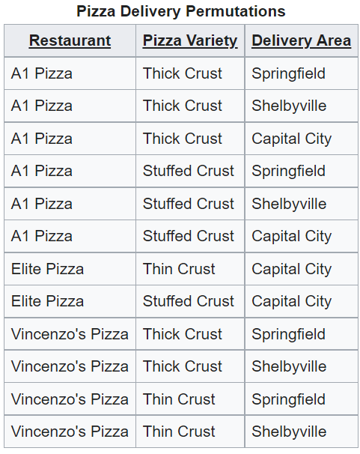
example

Slide 31
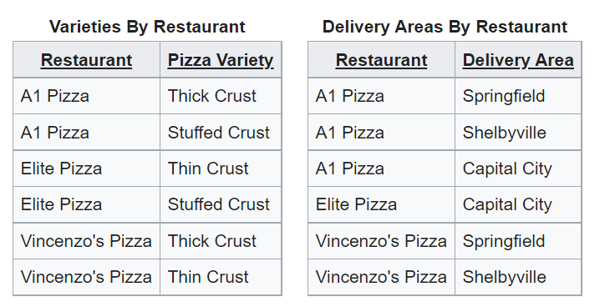
Converted into 4NF

Slide 32
Multivalued Dependency
Multivalued dependency occurs when two attributes in a table are independent of each other but, both depend on a third attribute.
A multivalued dependency consists of at least two attributes that are dependent on a third attribute that's why it always requires at least three attributes.

Slide 33
Example
Students 2mobile numbers and 2 gmail id
Stud_id | Mobile_no | Gmail_id
101 | 9729277722 | abc@gmail.com
101 | 9729277722 | abcd@gamil.com
101 | 9729277733 | abc@gmail.com
101 | 9729277733 | abcd@gmail.com

Slide 34
5 NF
It should be in 4NF.
There should be lossless decomposition

Slide 35
Lossless Decomposition
If the information is not lost from the relation that is decomposed, then the decomposition will be lossless.
The lossless decomposition guarantees that the join of relations will result in the same relation as it was decomposed.
The relation is said to be lossless decomposition if natural joins of all the decomposition give the original relation.

Slide 36

Example of lossy decomposition
A | B
1 | 2
2 | 2
3 | 3
A | B | C
1 | 2 | 1
2 | 2 | 2
3 | 3 | 2
Table2
B | C
2 | 1
2 | 2
3 | 2
Table1
Table3
A | B | B | C
1 | 2 | 2 | 1
1 | 2 | 2 | 2
1 | 2 | 3 | 2
2 | 2 | 2 | 1
2 | 2 | 2 | 2
2 | 2 | 3 | 2
3 | 3 | 2 | 1
3 | 3 | 2 | 2
3 | 3 | 3 | 2
Table2.B= table3.B
A | B | B | C
1 | 2 | 2 | 1
1 | 2 | 2 | 2
2 | 2 | 2 | 1
2 | 2 | 2 | 2
3 | 3 | 3 | 2

